Slide 1
Spring Sports Meeting
Baseball, Softball, Track & Field

Slide 2
Agenda
Registration & Eligibility
After School Expectations
Schedules & Attendance
MIAA Policies

Slide 3
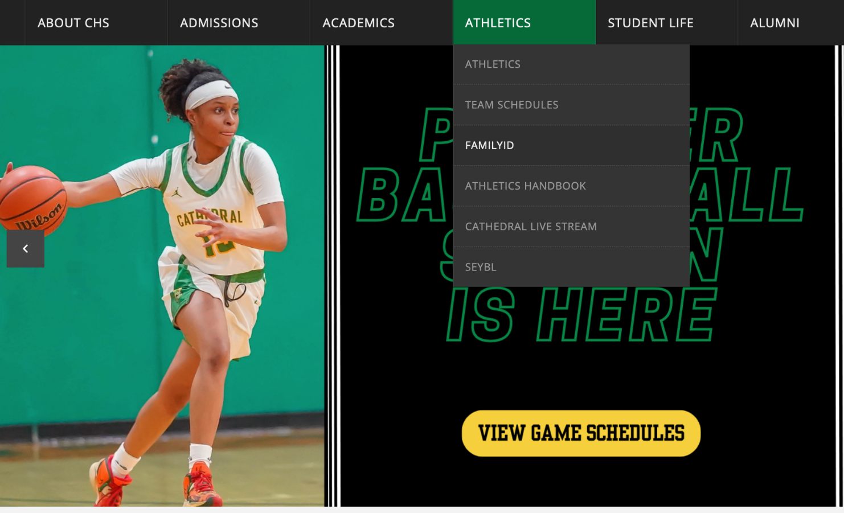
Registration & Eligibility
Every athlete must register on Family ID with an active physical BEFORE tryouts
Concussion/Implicit Bias
Physicals are valid for 13 months
Academic Eligibility:
2.0 GPA
Cannot fail more than one class

Slide 4
Schedule/Attendance
First day of tryouts:
March 18
Last Day of Regular Season: May 27
State Tournament begins May 30
Athletes cannot participate in practice or games if they are not present in school
Athletes must be present in school at least half day if tardy/dismissed early

Slide 5
Schedules cont.
Softball Practice:
3:30PM - 5:00PM at Rotch Field
Baseball Practice:
3:30PM - 5:00PM at Clifford Playground
Track Practice:
3:30 - 5:00PM at Madison Park Field
Spring Break:
April 15 - 19

Slide 6
After School/Athletic Training
Athletes are expected to do office hours after school
If you have any injury, see Athletic Trainer
March 22: Third quarter ends
AT will make decision on practice/game availability

Slide 7
MIAA Policies
Drugs, Alcohol, Marijuana, Pens, etc…
First Violation: suspension equaling 25% of the season
Second and subsequent violations: suspension equaling 60% of the season
Bullying/Hazing: expulsion
Fighting: two game suspension
Unsportsmanlike Conduct: one game

Slide 8
Breakout into individual teams…

